Slide 1
STORED PROCEDURES AND FUNCTIONS

Slide 2
Subprogram
PL/SQL subprograms are named PL/SQL blocks that can be invoked with a set of parameters. PL/SQL provides two kinds of subprograms −
Functions − These subprograms return a single value; mainly used to compute and return a value.
Procedures − These subprograms do not return a value directly; mainly used to perform an action.

Slide 3
STORED PROCEDURES
Stored Procedures are created to perform one or more DML operations on Database. It is nothing but the group of SQL statements that accepts some input in the form of parameters and performs some task and may or may not returns a value.
Syntax: Creating a Procedure:
CREATE or REPLACE PROCEDURE name(parameters)
IS variables;
BEGIN //statements;
END;

Slide 4
The most important part is parameters. Parameters are used to pass values to the Procedure. There are 3 different types of parameters, they are as follows:
IN: This is the Default Parameter for the procedure. It always receives the values from calling program.
OUT: This parameter always sends the values to the calling program.
IN OUT: This parameter performs both the operations. It Receives value from as well as sends the values to the calling program.

Slide 5
CREATE OR REPLACE PROCEDURE Demo(id IN number)
IS
BEGIN
dbms_output.put_line('Hi ' || id);
END;
BEGIN
Demo(1);
END;
Output:
Hi 1

Slide 6
Imagine a table named with emp_table stored in Database. We are Writing a Procedure to update a Salary of Employee with 1000.
CREATE or REPLACE PROCEDURE INC_SAL(eno IN NUMBER, up_sal OUT NUMBER)
IS
BEGIN
UPDATE emp_table SET salary = salary+1000 WHERE emp_no = eno;
COMMIT;
SELECT sal INTO up_sal FROM emp_table WHERE emp_no = eno;
END;

Slide 7
Write a procedure that computes the square of value of a passed value.
DECLARE
a number;
PROCEDURE squareNum(x IN OUT number) IS
BEGIN
x := x * x;
END;
BEGIN
a:= 12;
squareNum(a);
dbms_output.put_line(' Square of (12): ' || a);
END;

Slide 8
Functions in PL/SQL
A function can be used as a part of SQL expression i.e. we can use them with select/update/merge commands. One most important characteristic of a function is that unlike procedures, it must return a value.

Slide 9
CREATE [OR REPLACE] FUNCTION function_name [(parameter_name type [, ...])]
// this statement is must for functions
RETURN return_datatype
{IS | AS}
BEGIN // program code
[EXCEPTION exception_section;
END [function_name];
Where,
•function-name specifies the name of the function.
•[OR REPLACE] option allows the modification of an existing function.
•The optional parameter list contains name, mode and types of the parameters. IN represents the value that will be passed from outside and OUT represents the parameter that will be used to return a value outside of the procedure.
•The function must contain a return statement.
•The RETURN clause specifies the data type you are going to return from the function.
•function-body contains the executable part.
•The AS keyword is used instead of the IS keyword for creating a standalone function.

Slide 10
Structure to Define a function within PL/SQL
Declare
Global Variable Declarations;
Function FunctionName
( Argument IN Datatype, ……….)
Return DataType
IS/AS
Variable and Constant Declarations;
Begin
PL/SQL Statements;
Exception
Exception Handling Statements;
End FunctionName;
Begin
Executable Statements;
Function Calling;
Exception
Exception Handling Statements;
End;

Slide 11
Function: Example 1
create or replace function adder(n1 in number, n2 in number)
return number
is
n3 number(8);
begin
n3 :=n1+n2;
return n3;
end;
declare
num1 number(10);
num2 number(10);
c number(10);
function f101(num1 number, num2 number) return number IS
Begin
c:=num1+num2;
return c;
End f101;
begin
num1:= :num1;
num2:= :num2;
dbms_output.put_line(f101(num1,num2)); --calling of function
end;
DECLARE
n3 number(2);
BEGIN
n3 := adder(11,22);
dbms_output.put_line('Addition is: ' || n3);
END;

Slide 12
Function: Example 2
DECLARE
num number;
factorial number;
FUNCTION fact(x number)
RETURN number
IS
f number;
BEGIN
IF x=0 THEN
f := 1;
ELSE
f := x * fact(x-1);
END IF;
RETURN f;
END;
BEGIN
num:= 6;
factorial := fact(num);
dbms_output.put_line(' Factorial '|| num || ' is ' || factorial);
END;

Slide 13
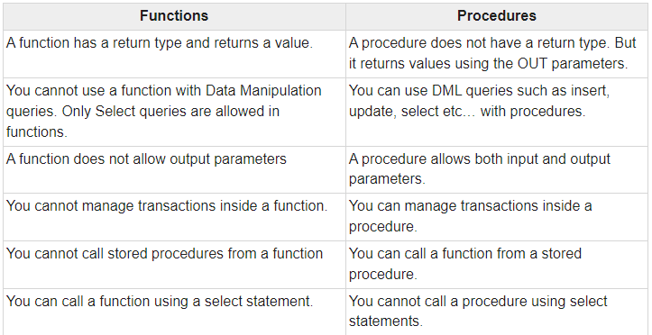
Difference between Stored Procedure and Functions

Slide 14
Triggers
A database trigger is a stored procedure that is fired when an INSERT, UPDATE, or DELETE statements is issued against the associate table.
The name trigger is appropriate, as these are triggered (fired) whenever the above-mentioned commands are executed.
A trigger defines an action the database should take when some database related event occur

Slide 15
Use of Database Triggers
To derive column values automatically.
To enforce complex integrity constraints.
To enforce complex business rules.
To customize complex security authorizations.
To maintain replicate tables.
To audit data modifications.

Slide 16
Triggers
A trigger is automatically executed without any action required by the user.
Procedures
Procedures can accept parameters.
A Stored Procedure needs to be explicitly invoked .
Triggers do not accept parameters

Slide 17
Parts of a Trigger
Triggering event or statement
insert, update or delete event
Trigger restriction
Is Boolean value true or false for trigger to fire.(when clause)
Trigger action
Code which is executed when event occurs

Slide 18
Types of Triggers
Oracle has the following types of triggers depending on the different applications:
Row Level Triggers
Statement Level Triggers
Before Triggers
After Triggers

Slide 19
Types of Triggers in Oracle
Triggers can be classified based on the following parameters.
Classification based on the timing
BEFORE Trigger: It fires before the specified event has occurred.
AFTER Trigger: It fires after the specified event has occurred.
INSTEAD OF Trigger: A special type. You will learn more about the further topics. (only for DML )
Classification based on the level
STATEMENT level Trigger: It fires one time for the specified event statement.
ROW level Trigger: It fires for each record that got affected in the specified event. (only for DML)
Classification based on the Event
DML Trigger: It fires when the DML event is specified (INSERT/UPDATE/DELETE)
DDL Trigger: It fires when the DDL event is specified (CREATE/ALTER)
DATABASE Trigger: It fires when the database event is specified (LOGON/LOGOFF/STARTUP/SHUTDOWN)

Slide 20
Syntax for Creating a Trigger
CREATE [OR REPLACE ] TRIGGER trigger_name
{BEFORE | AFTER}
{|DELETE| [OR] INSERT| [OR] UPDATE [ OF column_name,…]
ON table_name
[REFERENCING {OLD AS old, NEW AS new}]
[FOR EACH ROW [WHEN condition]
DECLARE
Variable declaration;
Constant declaration;
BEGIN
PL/SQL subprogram body;
[EXCEPTION
exception PL/SQL block;]
END;

Slide 21
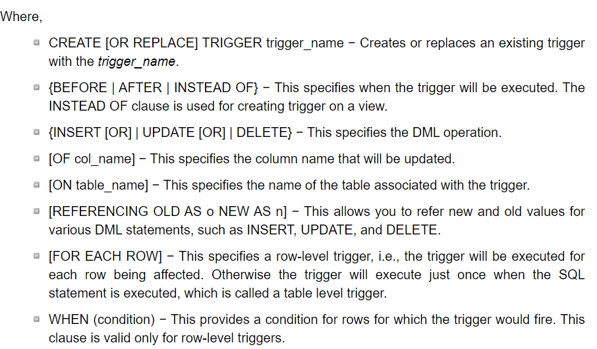

Slide 22
Create PL/SQL trigger which will tell about the operation performed on database.
Create or replace trigger t
Before INSERT or UPDATE or DELETE
ON Persons
Begin
IF INSERTING then
Dbms_output.put_line(‘operation performed inserting’);
ELSIF UPDATING then
Dbms_output.put_line(‘operation performed Updating’);
ELSE
Dbms_output.put_line(‘operation performed Deletion’);
End if;
End;
Notes:
Use Oracle live:
CREATE TABLE Persons (
PersonID int,
LastName varchar(255),
FirstName varchar(255),
Address varchar(255),
City varchar(255)
);
Create or replace trigger t
Before INSERT or UPDATE or DELETE
ON Persons
Begin
IF INSERTING then
Dbms_output.put_line('operation performed inserting');
ELSIF UPDATING then
Dbms_output.put_line('operation performed Updating');
ELSE
Dbms_output.put_line('operation performed Deletion');
End if;
End;
insert into Persons values( 1,'H1','H2','abc','xyz');

Slide 23
Create PL/SQL trigger which will convert the First name of the person to uppercase before inserting or updating the Firstname column of Persons database.

Slide 24
Create or replace trigger t
Before INSERT or UPDATE of NAME
ON Persons
For each row
Begin
:NEW.NAME := UPPER(:NEW.NAME);
End;
Notes:
Insert a new Row in the table Persons,
Verify whether FirstName has been automatically changed to upper case???

Slide 25
Create PL/SQL trigger which will delete the detail of the employee from employee table when particular branch is deleted from dept

Slide 26
Create or replace trigger t22
Before delete
On dept
For each row
Begin
Delete from employee where branch_id= :OLD.branch_id;
End;

Slide 27
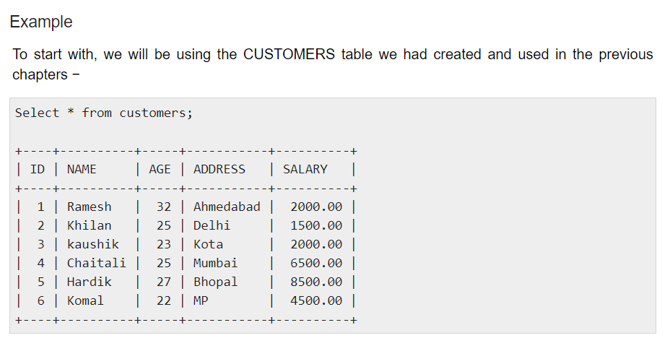

Slide 28
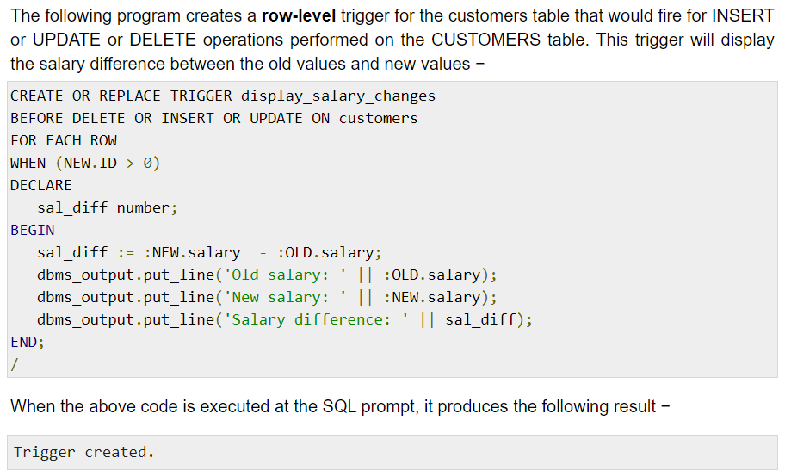

Slide 29
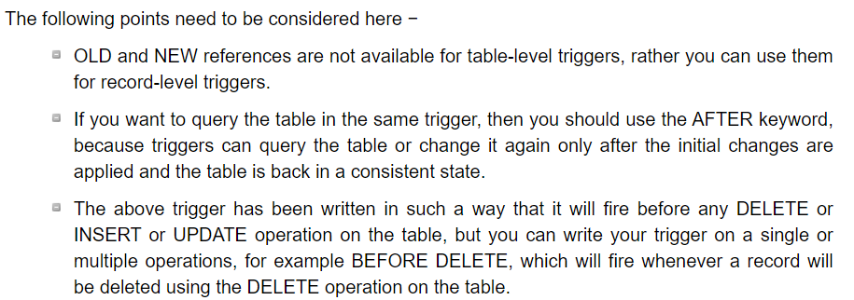

Slide 30
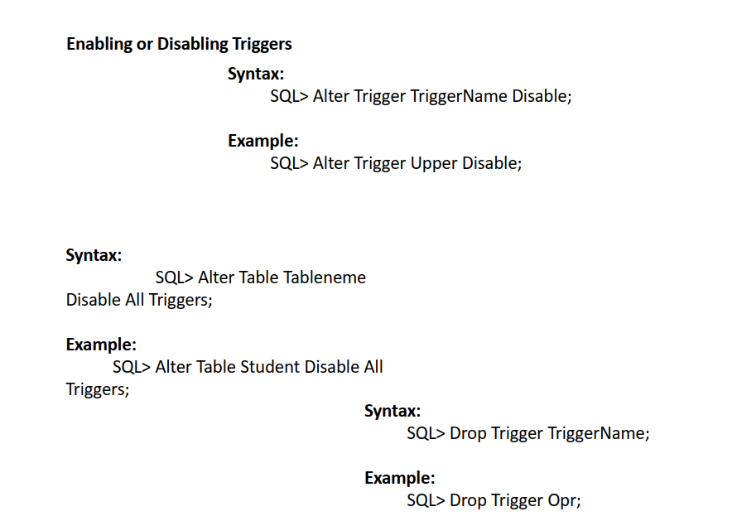

Slide 31
Cursors
A cursor is a work area where the result of a SQL query is stored at server side.
A cursor is a PL/SQL construct that allows us to name these work area.
The data stored in the cursor is known as active data set
Declare a cursor
Open a cursor
Fetch or Read from a cursor
Close cursor

Slide 32
Types of cursors
Implicit cursor
It is a work area that is declared, opened and closed internally by the oracle engine. PL/SQL declared a cursor implicitly for all SQL data manipulation statements.
Explicit cursor ( user defined)
It is a work area that is declared, opened and closed externally by the user.
Define in DECLARE section of PL/SQL block

Slide 33
General Cursor attributes
To keep status of a cursor:
%ISOPEN- returns true if cursor is open
%FOUND- returns true if record was fetched successfully
%NOTFOUND- returns true if record was not fetched successfully
%ROWCOUNT- returns number of records processed from cursor.

Slide 34
Implicit cursors
Implicit cursor attributes are used to access the information about the status of last insert, update, and delete or single row select statement. SQL is the default name for the implicit cursor.
Implicit cursor attributes:
SQL%ISOPEN- is always false because oracle engine closes the implicit cursor automatically after execution.
SQL%FOUND
SQL%NOTFOUND
SQL%ROWCOUNT

Slide 35
Write a PL/SQL block to display a message that whether a record is updated or not.
Begin
Update persons set firstname = 'hello12' where PersonID=4;
If SQL%FOUND then
Dbms_output.put_line('record updated');
End if;
If SQL%NOTFOUND then
Dbms_output.put_line('record not updated');
End if;
End;

Slide 36
Write a PL/SQL block to count the number of rows affected by an update statement
Declare
Num number(2);
Begin
Update Persons set city ='Delhi' where city ='uuuu';
Num := SQL%ROWCOUNT;
Dbms_output.put_line('total rows affected =' || Num);
End;

Slide 37
Explicit cursors
When a query returns multiple rows, user can explicitly declare a cursor to process the rows.
%ISOPEN
%FOUND
%NOTFOUND
%ROWCOUNT

Slide 38
Steps of execution
Declare the cursor
Open the cursor
Using loop, fetch the data from cursor one row at a time and store in memory variable
Exit from the loop
Close the cursor

Slide 39
Declaring a cursor
Cursor cursorname IS select statements.
Cursor C123 IS select rollno, name from student where branch=‘CSE’;

Slide 40
Opening a cursor
Opening a cursor executes the query and identifies the result set.
Open cursorname;
Eg:
Open C123;

Slide 41
Fetching from cursor
Fetch is used to load the rows from result set into memory variable, but one row at a time.
FETCH cursorname INTO variable;
Eg:
FETCH C123 INTO my_rollno, my_name;

Slide 42
Typically fetch statement is used with loop:
Loop
FETCH C123 into my_record;
Exit when C123%notfound;
--Other statements;
End loop;

Slide 43
Closing a cursor
CLOSE cursorname;
CLOSE C123;

Slide 44
Write a PL/SQL cursor to display the lastname of the Persons belonging to PersonId=‘1’

Slide 45
Declare
Cursor C123 is select lastname from Persons where PersonId ='1';
last_name Persons.lastname%type;
Begin
Open C123;
Loop
Fetch C123 into last_name;
Exit when C123%NotFound;
dbms_output.put_line(last_name);
End loop;
Close C123;
End;

